Slide 1
Reconstruction of chromosome’s local structure using HiC experimental data
Technical report Ofir Shukron

Slide 2
Background + motivation
Reconstruction of an “average” local structure (connectivity) of chromatin from HiC encounter data;
HiC/5C/4C/3C gives frequency of looping events in cell population;
No temporal information in the encounter frequency;
Cells display great variability in chromatin structure;

Slide 3
Agenda
The data
Smoothing method for the HiC data
Transform probabilities to distances
Results of reconstruction
Comparison to experimental data
Perspectives
Data processing
reconstruction
comparison

Slide 4
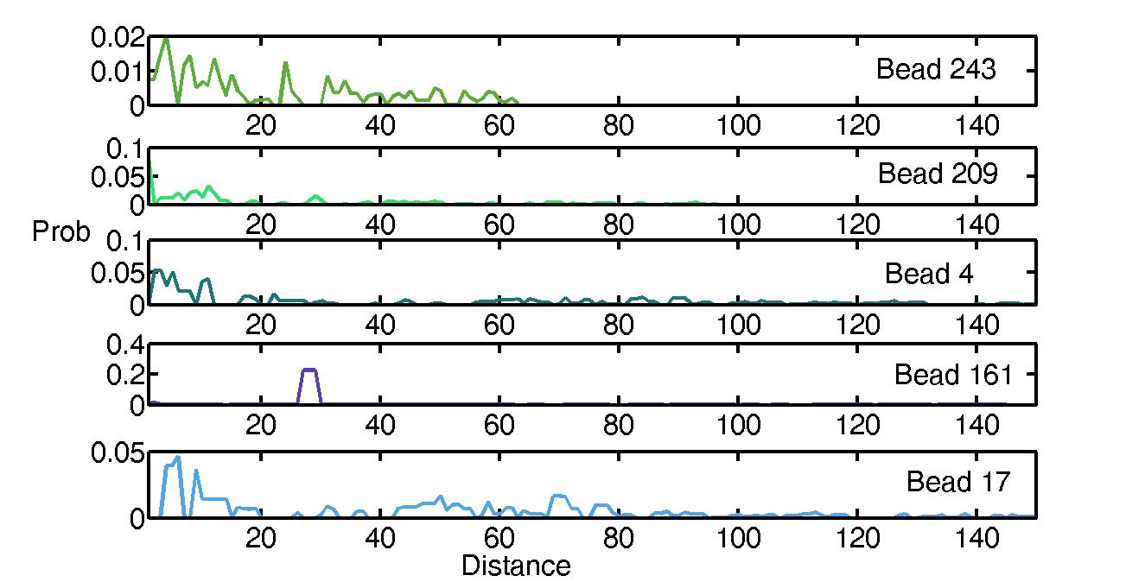
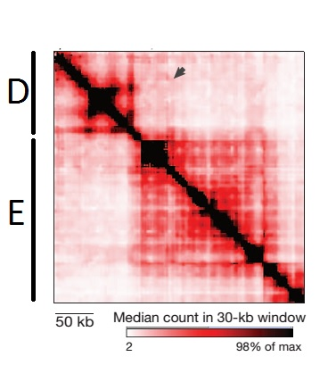
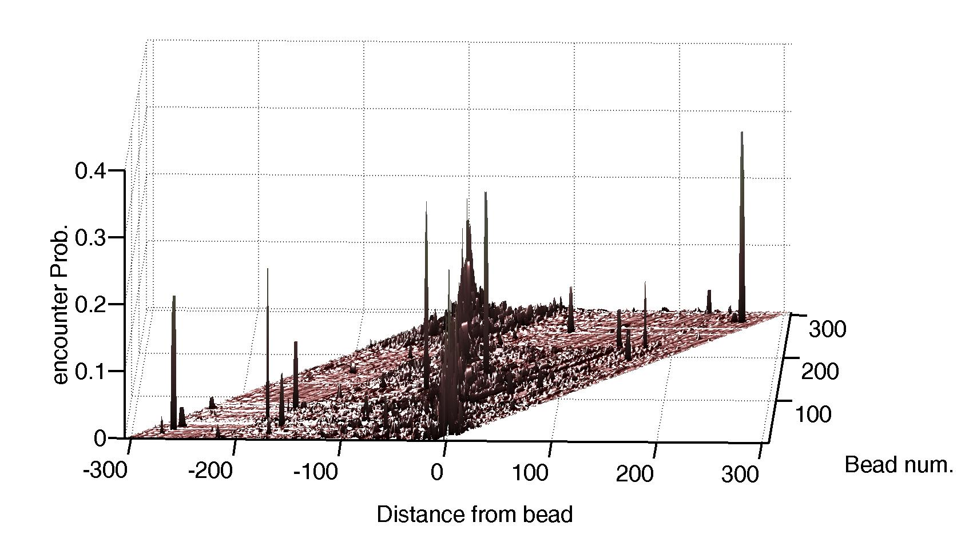
The Data
4
Right encounters
1
3
Encounter Freq.
Encounter Prob. Centered view
2
left
right
1
N

Slide 5
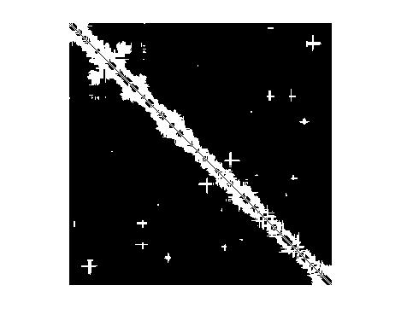
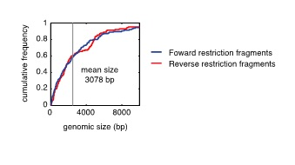
Reconstruction output
Encounter frequency
Connectivity (structure) map
Connected Not connected

Slide 6
Scope and assumptions
The HiC represent the equilibrium encounter distribution;
HiC data is “noisy”;
The underlying polymer model is Rouse;
Reconstructed polymer will represents an “average” structure.

Slide 7
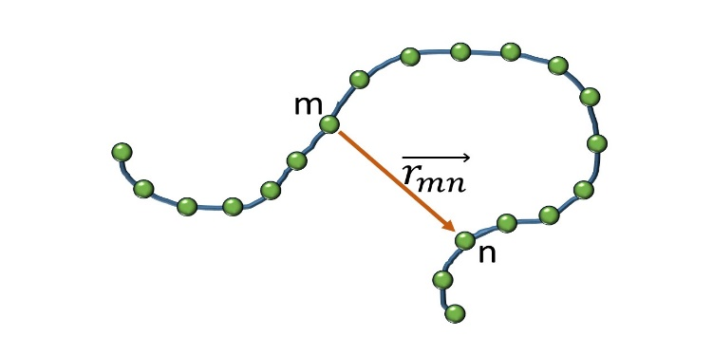
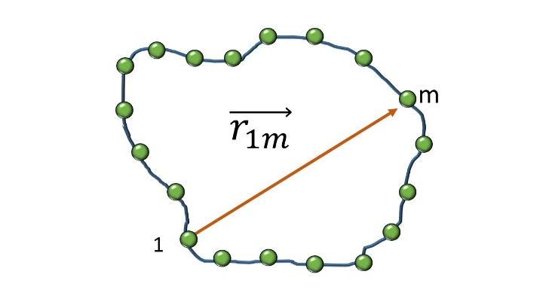
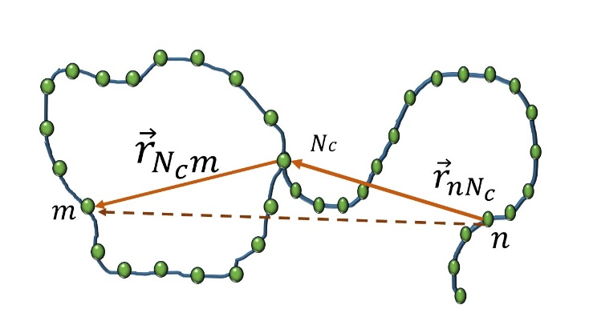

Encounter probabilities under the Rouse assumption
For linear Rouse chain with $N$ beads. The vector between beads m and n is Normal with: ${ f_{C}\left(x;m,n\right)=\left(\frac{3}{2π\left|m−n\right|}\right)}^{1.5}exp⁡\left(\frac{−3x^{2}}{2{\left|m−n\right|}^{2}}\right)$ Setting $x=0$ we get the encounter probability
The Rouse ring with $N_{r}$ beads is a Brownian bridge with$N_{r}$steps, the vector between beads at distance $m$from each other is given by: ${f_{R}\left(x;m\right)=\left(\frac{3}{2πm (N_{r}−m)}\right)}^{1.5}\exp\left(\frac{−3x^{2}}{2(m{\left(N_{r}−m\right))}^{2}}\right)$ setting $x=0$ gives the encounter probability
In a composite structure, the vector is given by the addition of two Normally distributed vectors
$$f_{com}\left(x;n,m\right)=f_{C}\left(x;n,N_{c}\right)∗f_{R}\left(x;\left|N_{c}−m\right|\right)$$
More complex structures follow similar logic as above

Slide 8
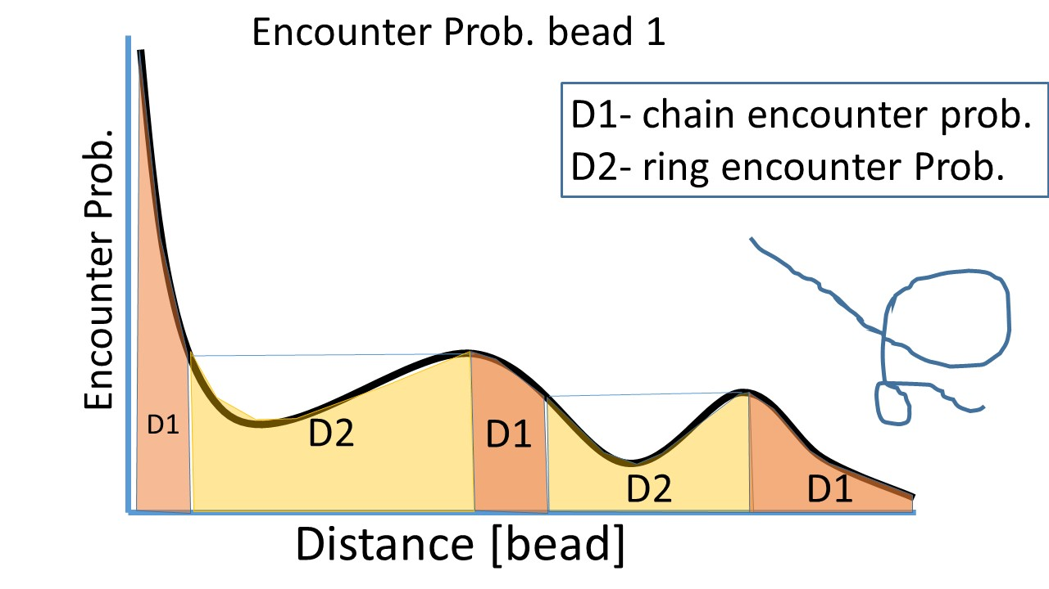
From encounter probabilities to structure- theory
Under the Rouse polymer assumption, equal encounter probabilities indicates equal distances along the chain
1

Slide 9
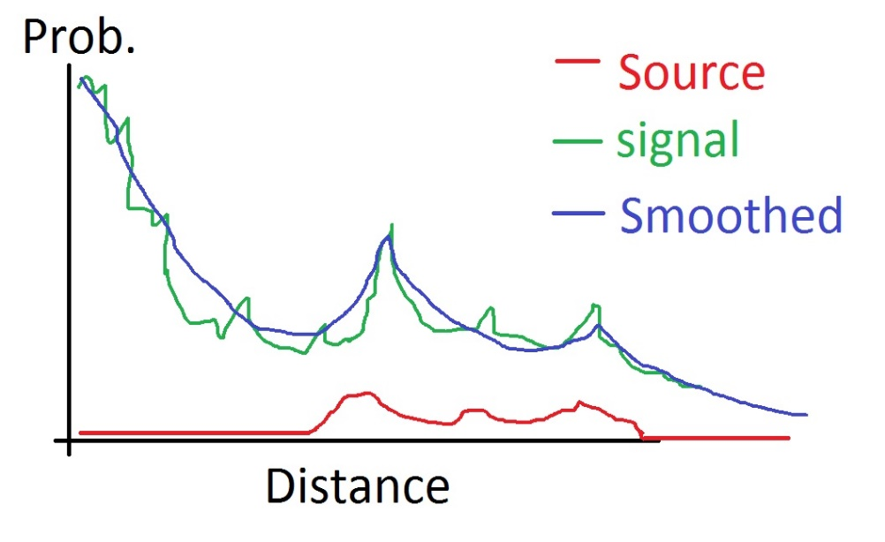
Noisy encounter signal
Experimental signal are not “well behaved”.
Missing observations for some beads
The distribution of vectors between beads is the fundamental solution to the diffusion (heat) equation, under Rouse assumption
The composition of fundamental solution is unknown
A theoretical heat source function will help us find it.

Slide 10






Smoothing by solving the inverse heat source problem
Theory
Practice
1. Find a function $r(t)$and temperature $u(x,t)$ which satisfy the eq.
$$u_{t}=u_{xx}+r\left(t\right)f(x,t)$$
Subject to:
$$u\left(0,t\right)=u\left(1,t\right), u_{x}\left(0,t\right)+αu\left(0,t\right)=0$$
$$u\left(x,0\right)=φ\left(x\right), \int_{0}^{1}{u\left(x,t\right)dx=E(t)}$$
[Hazanee et. al. 2013]
For each HiC signal $u^{∗}(t)$ we set: $f\left(x,t\right)=1, 0≤x≤1, 0≤t≤T$
$$u\left(0,t\right)=u\left(1,t\right)=u^{∗}(t), u_{x}\left(0,t\right)+αu\left(0,t\right)=0$$
$$α=−1$$
Initial conditions:
$φ\left(x\right)=u\left(x,0\right)=u^{∗}(0)$
Heat energy:
$$\int_{0}^{1}{u\left(x,t\right)dx}=E(t)$$
Using the Boundary Element method (BEM) Hazanee et. al. devised a scheme for the inverse heat source
$$u\left(x,0\right)=u^{∗}(0)$$
Observed Temp.
$$u(1,t)$$
1
We search the solution at the initial point $x=0$ for which we get encounter probability.
The ill posdness requires the use of Tikhonov regularization term
space
Temp
0
$$u(0,t)$$
T
Time

Slide 11
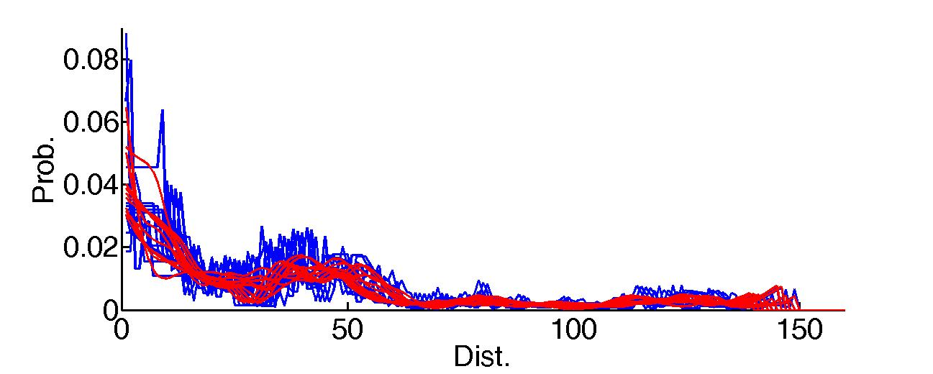
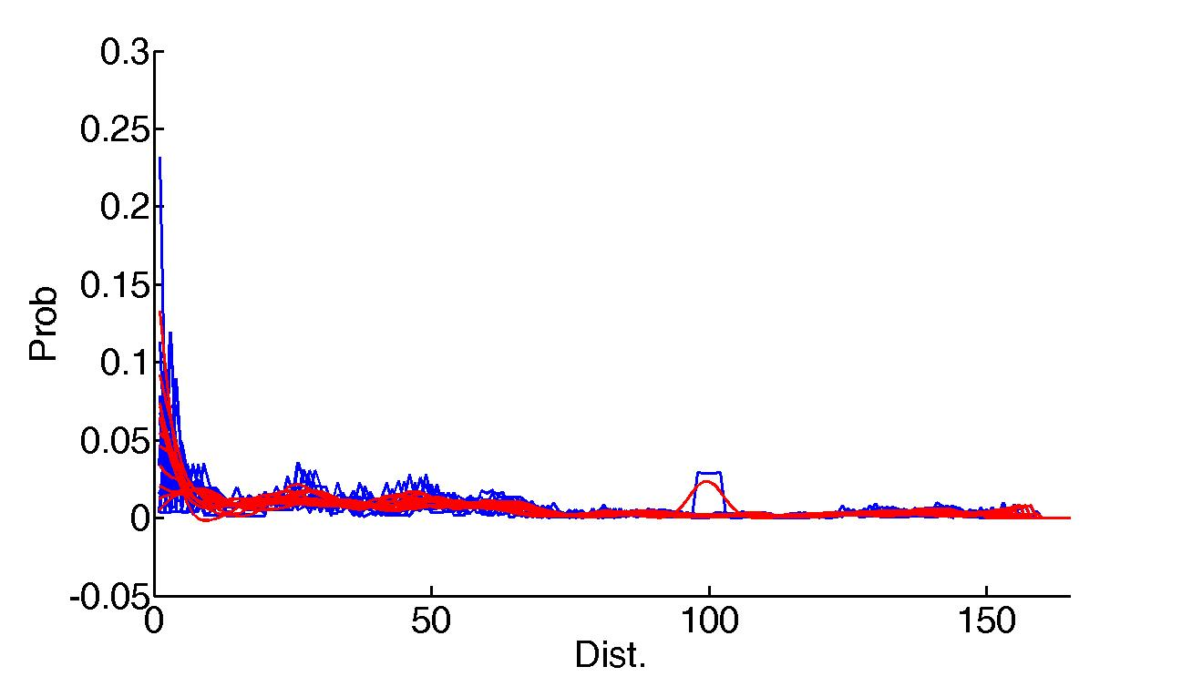
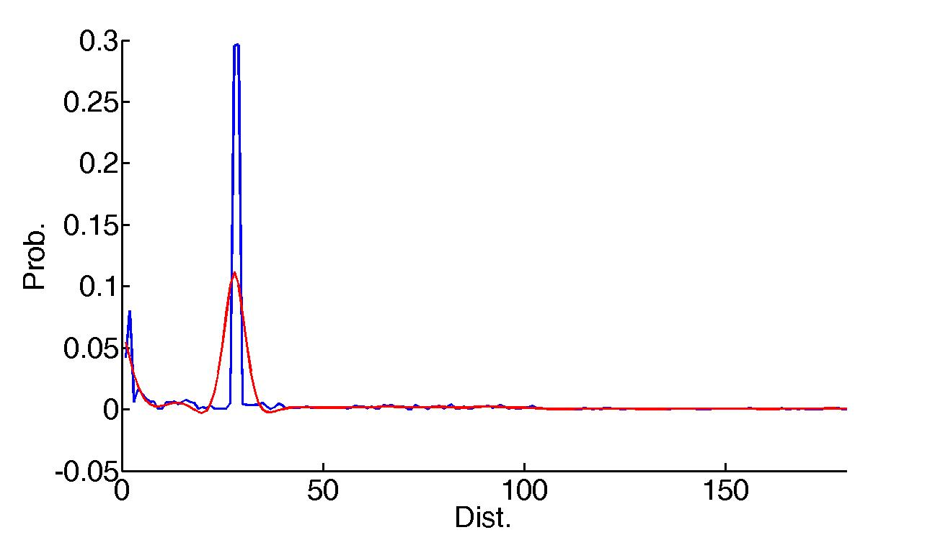
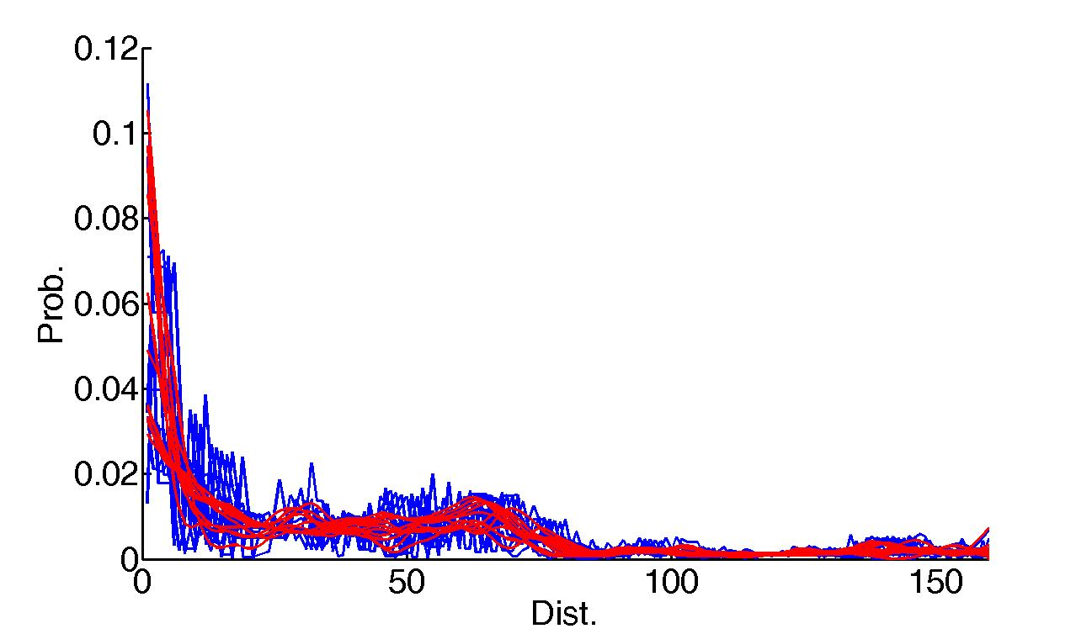
Some smoothing results
140-150
160-170
191
150-160

Slide 12
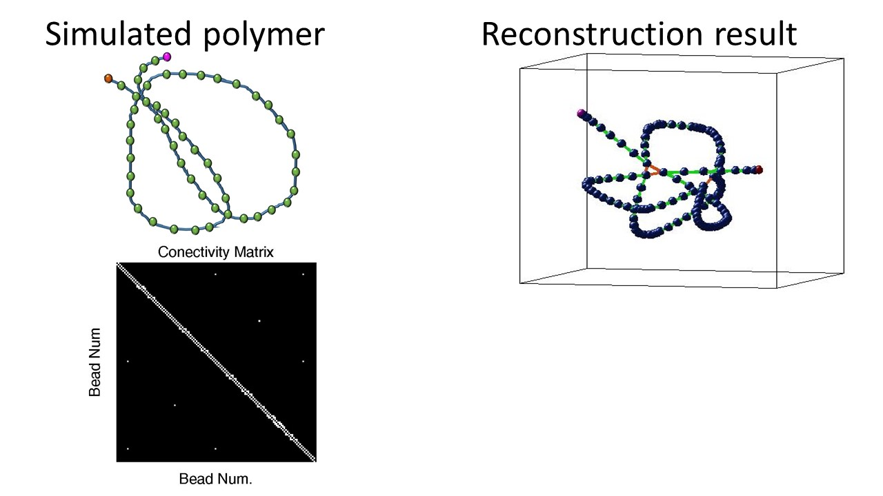
Reconstruction
After projection, round to the nearest integer to get connectivity
Before applying it on the HiC data, test with synthetic example
Test on synthetic example

Slide 13
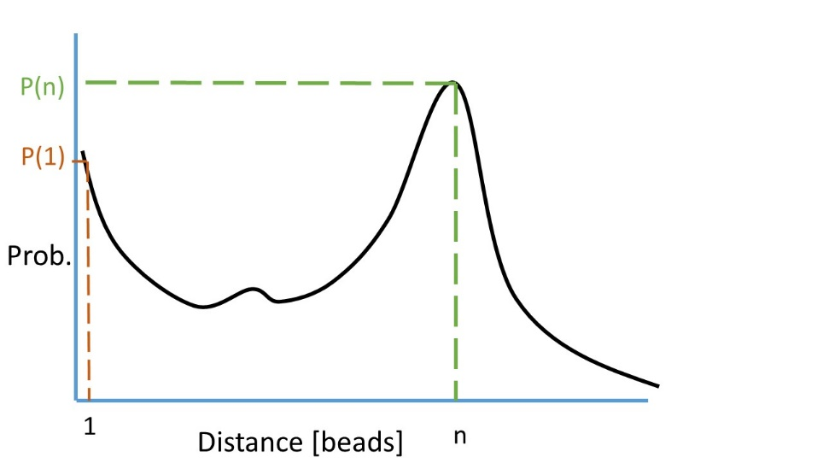
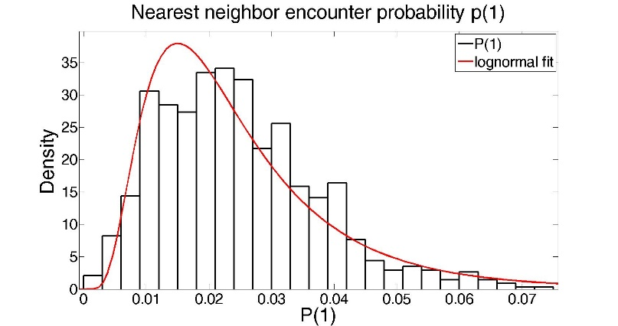
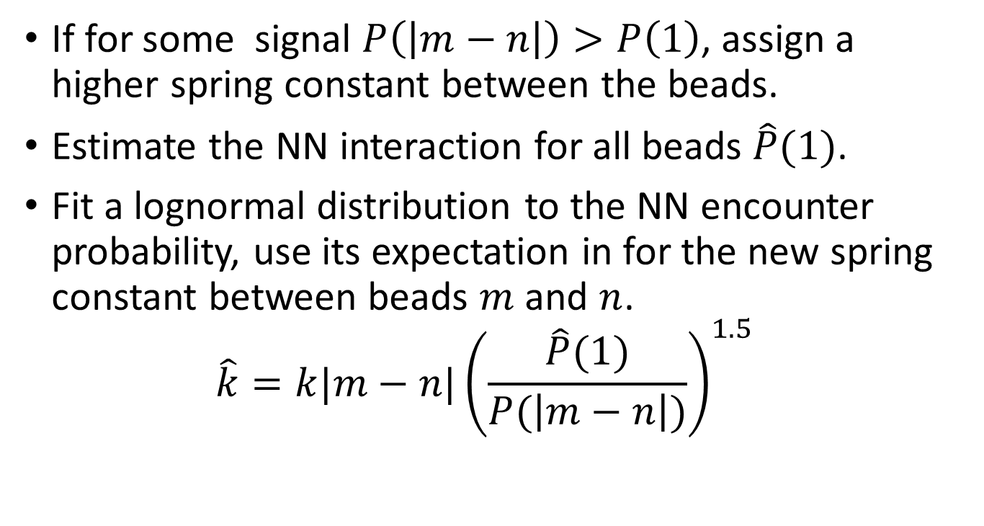
Adjusting the spring constant
If for some signal $P\left(\left|m−n\right|\right)>P\left(1\right)$, assign a higher spring constant between the beads.
Estimate the NN interaction for all beads $\hat{P}(1)$.
Fit a lognormal distribution to the NN encounter probability, use its expectation in for the new spring constant between beads $m$ and $n$. $\hat{k}=k|m−n|{\left(\frac{\hat{P}(1)}{P(\left|m−n\right|)}\right)}^{1.5}$

Slide 14
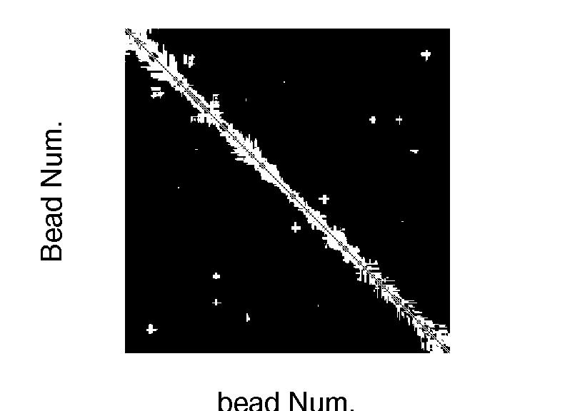
HiC data
Connectivity Matrix
Connected Not connected

Slide 15
To be done
Reconstruction
Statistical test for agreement with loop location
Comparison measure between experimental and reconstructed (simulated)
Regularization term in smoothing, to be chosen automatically
Comparison of smoothing methods
simulations
The mean first encounter time for different parts of the chain
Analytical
Find method to diagonalize general connectivity matrix

